Slide 1




SRM
INSTITUTE OF SCIENCE AND TECHNOLOGY,
CHENNAI.
18CSC201J
DATA STRUCTURES AND ALGORITHMS
Unit- V

Slide 2

SRM
INSTITUTE OF SCIENCE AND TECHNOLOGY,
CHENNAI.
Hashing
Topics covered: quadratic, double, rehashing and extensible hashing

Slide 3
Open Addressing (Probing)
Open addressing / probing is carried out for insertion into fixed size hash tables (hash tables with 1 or more buckets). If the index given by the hash function is occupied, then increment the table position by some number.

Slide 4
There are three schemes commonly used for probing:
Linear Probing: The linear probing algorithm is detailed below:
Index := hash(key)
While Table(Index) Is Full do
index := (index + 1) MOD Table_Size
if (index = hash(key))
return table_full
else
Table(Index) := Entry
Quadratic Probing: increment the position computed by the hash function in
quadratic fashion i.e. increment by 1, 4, 9, 16, ….
Double Hash: compute the index as a function of two different hash functions.

Slide 5
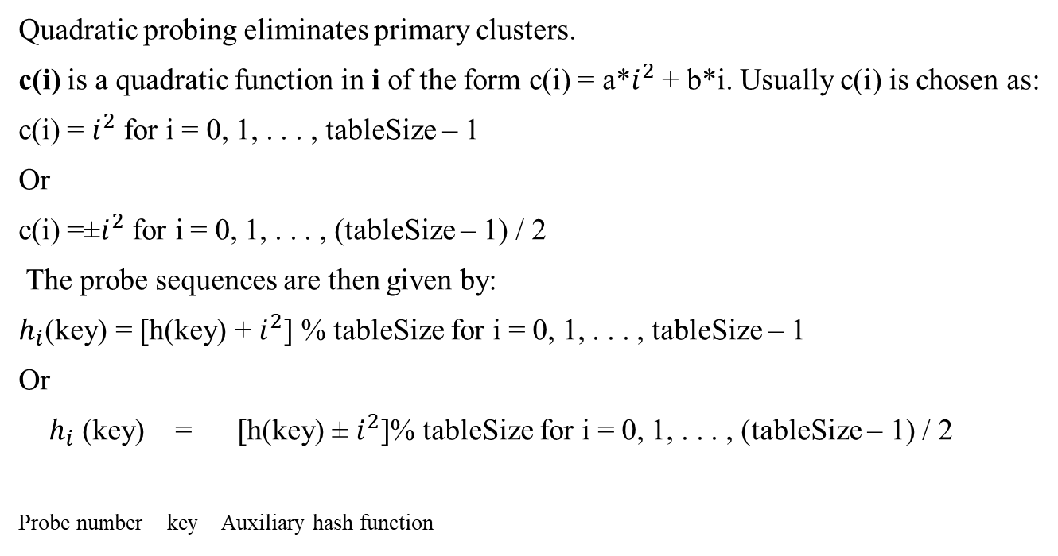
Quadratic Probing
Quadratic probing eliminates primary clusters.
c(i) is a quadratic function in i of the form c(i) = a*$i^{2}$ + b*i. Usually c(i) is chosen as:
c(i) = $i^{2}$ for i = 0, 1, . . . , tableSize – 1
Or
c(i) =±$i^{2}$ for i = 0, 1, . . . , (tableSize – 1) / 2
The probe sequences are then given by:
$h_{i}$(key) = [h(key) + $i^{2}$] % tableSize for i = 0, 1, . . . , tableSize – 1
Or
$h_{i}$ (key) = [h(key) ± $i^{2}$]% tableSize for i = 0, 1, . . . , (tableSize – 1) / 2
Probe number key Auxiliary hash function

Slide 6
Properties of quadratic hashing
Hashtable size should not be an even number; otherwise Property 2 will not be satisfied.
Ideally, table size should be a prime of the form 4j+3,where j is an integer. This choice of table size guarantees Property 2.

Slide 7
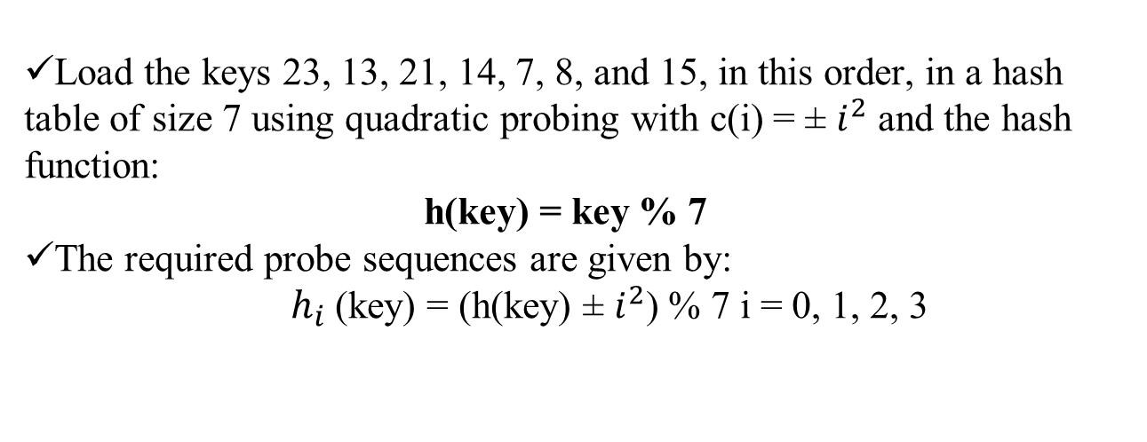
Example:Quadratic Probing
Load the keys 23, 13, 21, 14, 7, 8, and 15, in this order, in a hash table of size 7 using quadratic probing with c(i) = ± $i^{2}$ and the hash function:
h(key) = key % 7
The required probe sequences are given by:
$h_{i}$(key) = (h(key) ± $i^{2}$) % 7 i = 0, 1, 2, 3

Slide 8
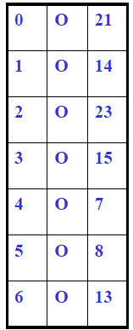

Computations
hi(key) = (h(key) ± $i^{2}$) % 7 i = 0, 1, 2, 3
h0(23) = (23 % 7) % 7 = 2
h0(13) = (13 % 7) % 7 = 6
h0(21) = (21 % 7) % 7 = 0
h0(14) = (14 % 7) % 7 = 0 collision
h1(14) = (0 + 12) % 7 = 1
h0(7) = (7 % 7) % 7 = 0 collision
h1(7) = (0 + 12) % 7 = 1 collision
h-1(7) = (0 - 12) % 7 = -1
NORMALIZE: (-1 + 7) % 7 = 6 collision
h2(7) = (0 + 22) % 7 = 4
h0(8) = (8 % 7)%7 = 1 collision
h1(8) = (1 + 12) % 7 = 2 collision
h-1(8) = (1 - 12) % 7 = 0 collision
h2(8) = (1 + 22) % 7 = 5
h0(15) = (15 % 7)%7 = 1 collision
h1(15) = (1 + 12) % 7 = 2 collision
h-1(15) = (1 - 12) % 7 = 0 collision
h2(15) = (1 + 22) % 7 = 5 collision
h-2(15) = (1 - 22) % 7 = -3
NORMALIZE: (-3 + 7) % 7 = 4 collision
Quadratic probing is better than linear probing because it eliminates primary clustering.

Slide 9
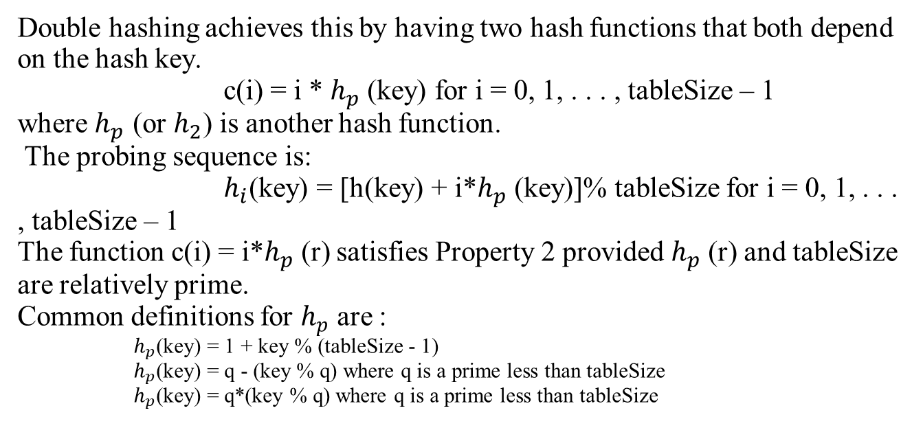
Double Hashing
Double hashing achieves this by having two hash functions that both depend on the hash key.
c(i) = i * $h_{p}$(key) for i = 0, 1, . . . , tableSize – 1
where $h_{p}$ (or $h_{2}$) is another hash function.
The probing sequence is:
$h_{i}$(key) = [h(key) + i*$h_{p}$(key)]% tableSize for i = 0, 1, . . . , tableSize – 1
The function c(i) = i*$h_{p}$(r) satisfies Property 2 provided $h_{p}$(r) and tableSize are relatively prime.
Common definitions for $h_{p}$ are :
$h_{p}$(key) = 1 + key % (tableSize - 1)
$h_{p}$(key) = q - (key % q) where q is a prime less than tableSize
$h_{p}$(key) = q*(key % q) where q is a prime less than tableSize

Slide 10
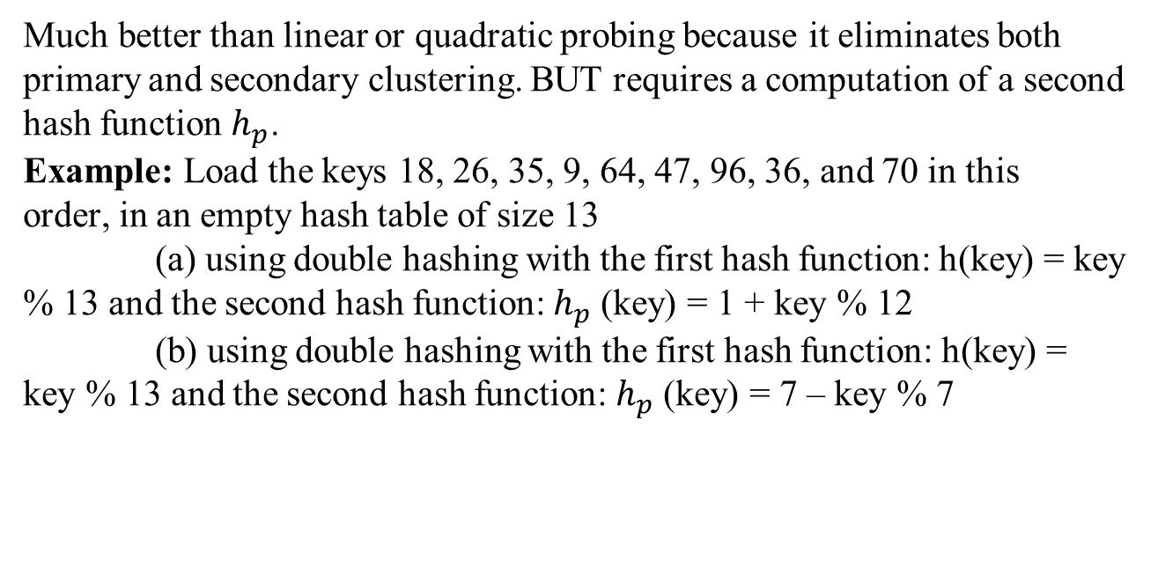
Performance and example of Double hashing
Much better than linear or quadratic probing because it eliminates both primary and secondary clustering. BUT requires a computation of a second hash function $h_{p}$.
Example: Load the keys 18, 26, 35, 9, 64, 47, 96, 36, and 70 in this
order, in an empty hash table of size 13
(a) using double hashing with the first hash function: h(key) = key % 13 and the second hash function: $h_{p}$(key) = 1 + key % 12
(b) using double hashing with the first hash function: h(key) =
key % 13 and the second hash function: $h_{p}$(key) = 7 – key % 7

Slide 11
Computation
h0(18) = (18%13)%13 = 5
h0(26) = (26%13)%13 = 0
h0(35) = (35%13)%13 = 9
h0(9) = (9%13)%13 = 9 collision
hp(9) = 1 + 9%12 = 10
h1(9) = (9 + 1*10)%13 = 6
h0(64) = (64%13)%13 = 12
h0(47) = (47%13)%13 = 8
h0(96) = (96%13)%13 = 5 collision
hp(96) = 1 + 96%12 = 1
h1(96) = (5 + 1*1)%13 = 6 collision
h2(96) = (5 + 2*1)%13 = 7
h0(36) = (36%13)%13 = 10
h0(70) = (70%13)%13 = 5 collision
hp(70) = 1 + 70%12 = 11
h1(70) = (5 + 1*11)%13 = 3
hi(key) = [h(key) + i*hp(key)]% 13
h(key) = key % 13
hp(key) = 1 + key % 12

Slide 12
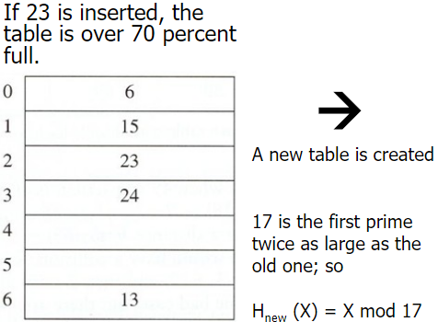
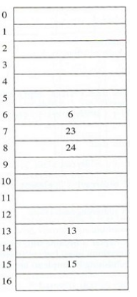
Rehashing
Rehashing is with respect to closed hashing. When we try to store the record with Key1 at bucket
Hash(Key1) position and find that it already holds a record, it is collision situation
To handle collision, we use strategy to choose a sequence of alternative locations Hash1(Key1), Hash2(Key1), … within the bucket table so as to place the record with Key1

Slide 13
Extendible hashing
Extendible hashing is based on a radix-2 trie. The idea is to hash the key, yielding a long two-bit number. Then, use as many bits as desired to create a radix-2 trie.
But, instead of building a tree, just collapse the tree, interpreting the 0/1 sequence along each branch as a binary number, used as the index into the bucket array.
When collision occurs, more bits can be used to divide the buckets into a larger (by powers of 2) address space.

Slide 14
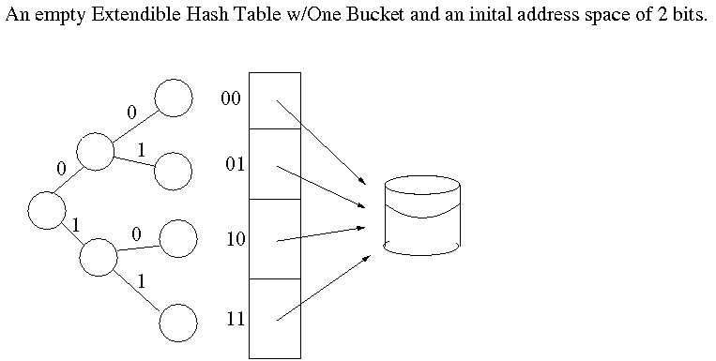
Illustration of Extendible hashing

Slide 15
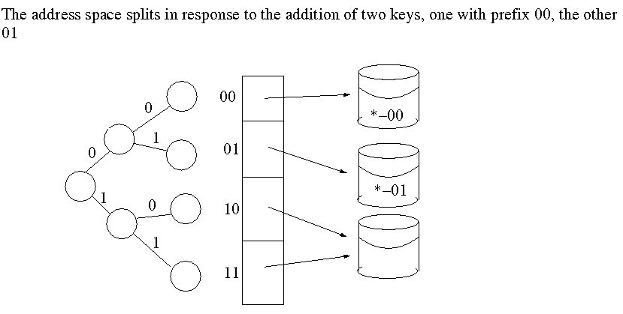
Illustration of Extendible hashing

Slide 16
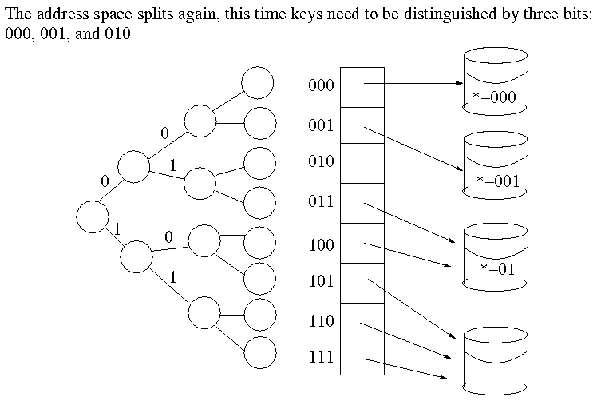
Illustration of Extendible hashing

Slide 17
References
*Reema Thareja, “Data Structures Using C”, Oxford Higher Education, First Edition,
2011.
*https://www.slideshare.net/HanifDurad/chapter-12-ds
*https://www.slideshare.net/sumitbardhan/358-33-powerpointslides15hashingcollisionchapter15
*andrew.cmu.edu/course/15-310/applications/ln/lecture12.html

